Slide 1


Denoising Diffusion Probabilistic Models (DDPM)
April 12th, 2023
Ahmad Shmayssani
Mouhamad Obeid

Slide 2
Background on Generative Models What are they? Why are they needed?
Diffusion Models Development of Diffusion Models DDPM - A Diffusion-Based Model Forward Model Reverse Model
Algorithms Training & Sampling Algorithms
Replication of Results Diffusion Model Application Line vs Cosine Variance Schedule

Slide 3

Generative Models

Slide 4

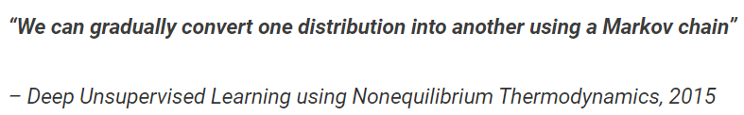
Development of Diffusion Models
First Introduced by:
Sohl-Dickstein et al., 2015
Independently improved the approach:
Song et al., 2019 (at Stanford University)
Ho et al., 2020 (at Google Brain)

Slide 5
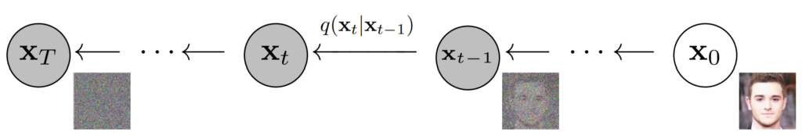
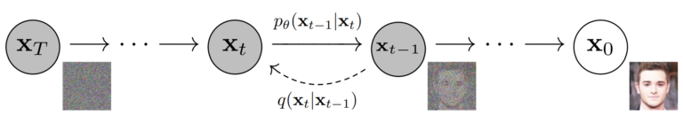
Diffusion Model
Forward Process
Reverse Process
Notes:
High level intro of the model explained in the paper

Slide 6
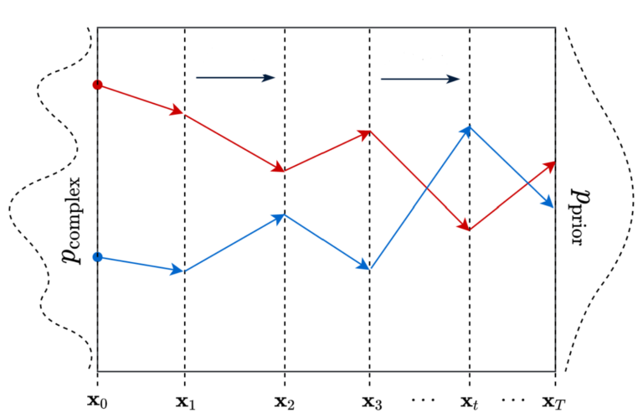
Forward Diffusion
In the “Forward Diffusion” process, we slowly and iteratively add noise to the images in our training set.
Our goal is to convert the unknown and complex distribution that our training set belongs to into one that is easy for us to sample.
At the end of the forward process, the images become entirely unrecognizable.
Notes:
High level intro of the model explained in the paper

Slide 7
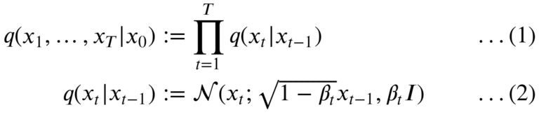
Forward Diffusion
It denotes the “transition function” applied at each step in the forward diffusion process.
It defines the PDF of an image at timestep t in the forward diffusion process xt given image xt-1.
It denotes the posterior of the Forward Process, is fixed to a Markov chain that gradually adds Gaussian noise to the data.
It captures the temporal evolution of the system over the entire sequence of intermediate states.
Notes:
Talk about applications before introducing the model

Slide 8
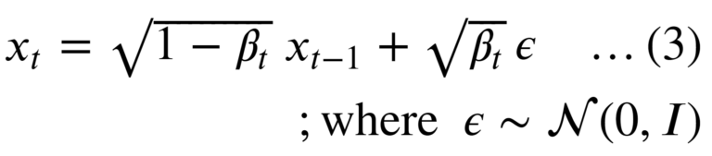
Forward Diffusion
How do we get image xt from xt-1
Here, the epsilon ɛ is the “noise” term that is randomly sampled from the standard gaussian distribution and is first scaled and then added (scaled) x(t-1).
Notes:
Talk about applications before introducing the model

Slide 9
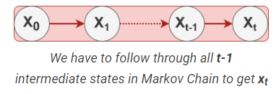
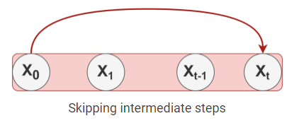
Forward Diffusion
Are there any Problems?
Whenever we need a latent sample x at timestep t, we have to perform t-1 steps in the Markov chain.
To fix this, the authors reformulated the kernel to directly go from timestep 0 (i.e., from the original image) to timestep t in the process.
Notes:
Talk about applications before introducing the model

Slide 10
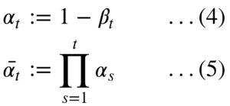
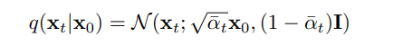
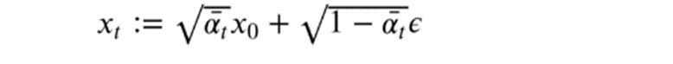
Forward Diffusion
How to do so?
2 Additional Terms are defined
Replacing β with α and using the additive property of Gaussian Distribution
Notes:
Talk about applications before introducing the model

Slide 11
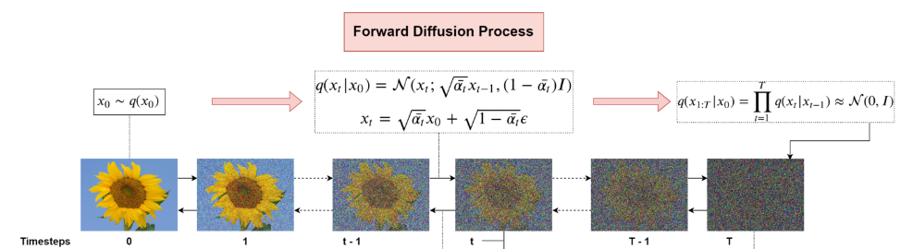
Forward Diffusion
Complete Process
Notes:
Talk about applications before introducing the model

Slide 12
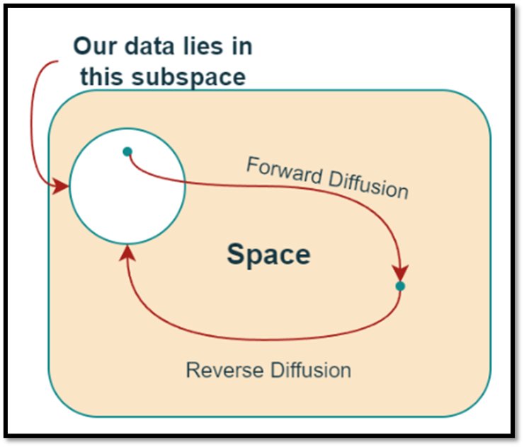
Image Space

Slide 13
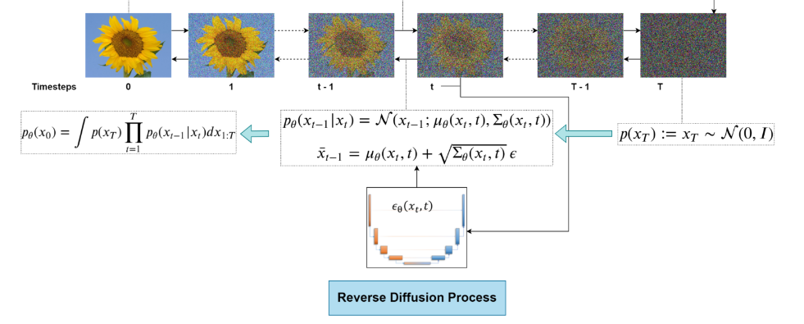
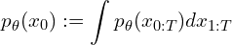
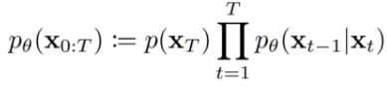
Reverse Diffusion

Slide 14
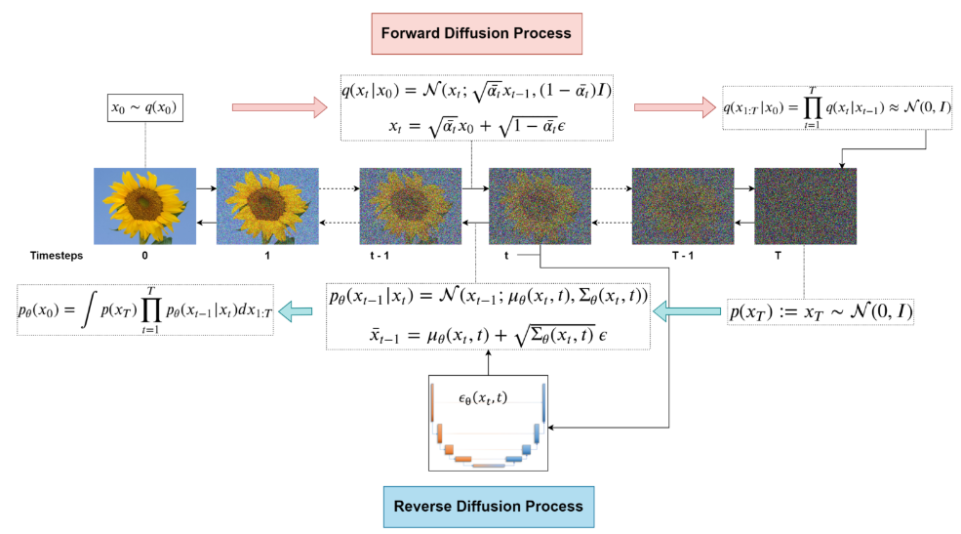
Equations Related to Forward & Reverse Processes
Notes:
Might Remove

Slide 15
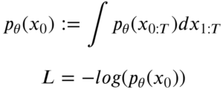
Training Objective & Loss Function
“maximize the log-likelihood of the sample generated (at the end of the reverse process) (x) belonging to the original data distribution.”
General Form
Intractable!
Need to integrate over a very high dimensional (pixel) space for continuous values over T timesteps!

Slide 16
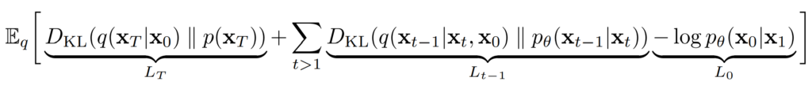
Reformulation
VLB aka ELBO:
Then the simplified loss VLB is just the Lt-1 term:
Notes:
Might Remove

Slide 17
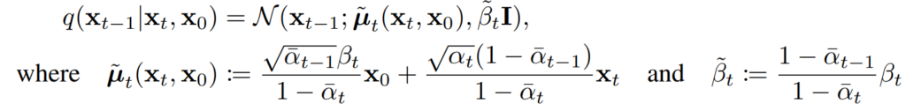
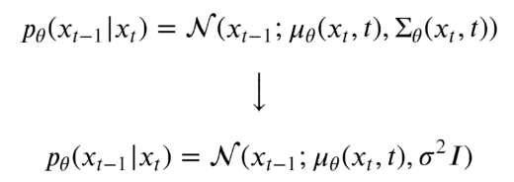
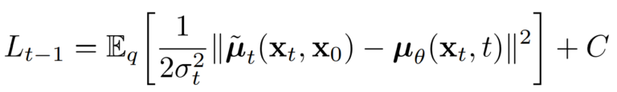
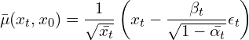
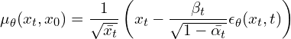
Assumption: Fixed Variance
Forward Process
Reverse Process
VLB Loss function
Notes:
Might Remove

Slide 18
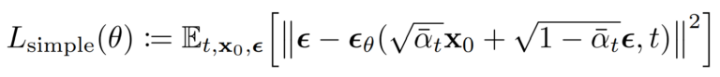
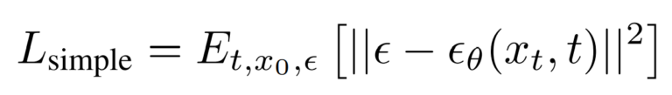
Final Loss Function
“Mean Squared Error (MSE)” between the noise added in the forward process and the noise predicted by the model.
Notes:
Might Remove

Slide 19
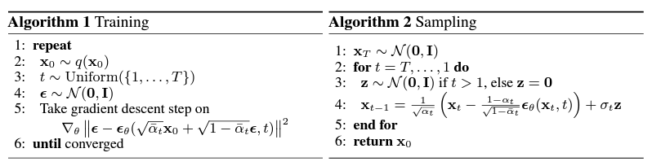
Training algorithm
Take a random sample x0 from original distribution
Sample a noise level t uniformly from the set {1, . . . , T}.
Sample noise ε from a standard normal distribution and corrupt image at noise level t
The gradient descent step is taken on the negative log-likelihood loss.
The neural network is trained to predict the noise based on the corrupted image xt (i.e. noise applied on x0 according to known variance schedule)
Notes:
Might Remove

Slide 20
Sampling algorithm
Initialize xT from a standard normal distribution.
Loop backwards from t=T to t=1.
For each time step, sample z from a standard normal distribution if t > 1, otherwise set z to zero.
Compute xt-1 as a combination of the previous time step xt and the noise z using the neural network parameters theta and the diffusion coefficient alpha.
Repeat until t=1 and return x0 which is a is a denoise image, after applying reverse steps to the original image.
Notes:
Might Remove

Slide 21


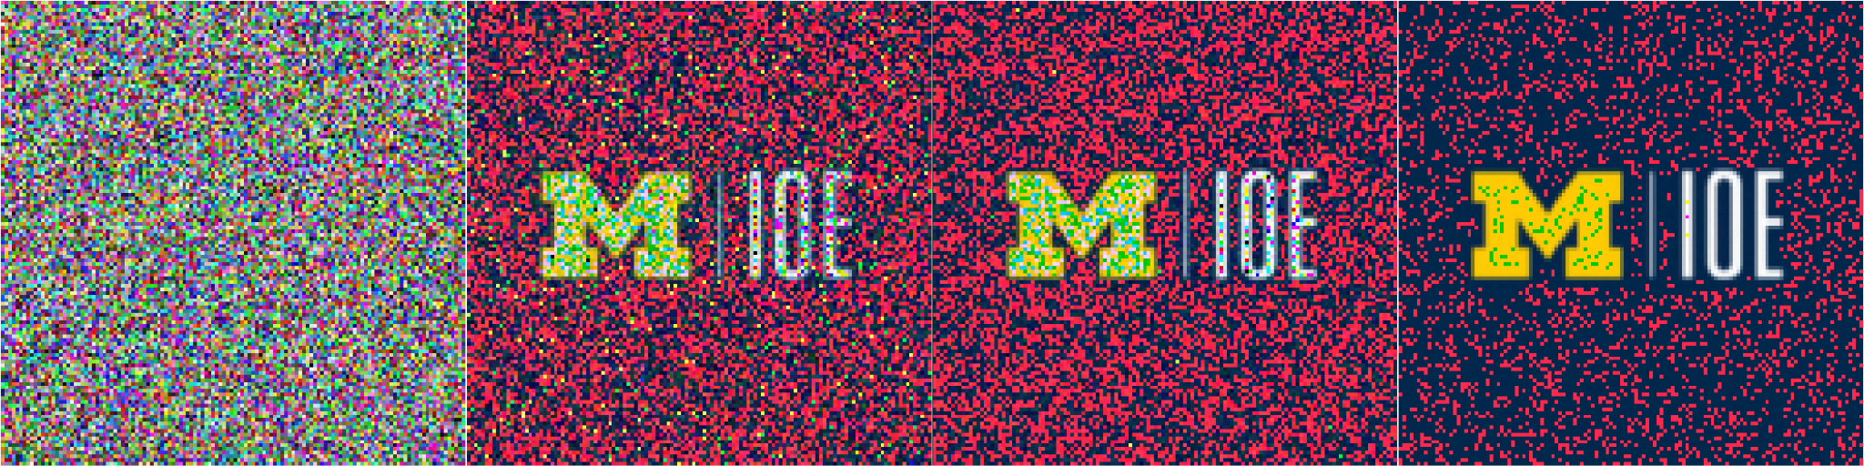
Diffusion Sample Replications
T=0
T=100
T=200
T=300
x0
Forward
T=300
T=200
T=100
T=0
Backward
Notes:
Might Remove

Slide 22
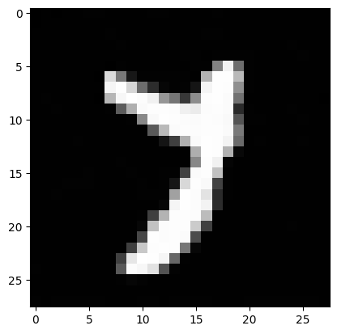
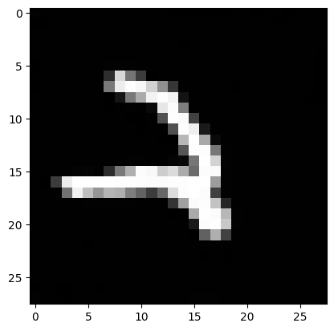
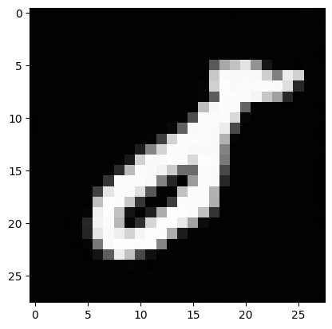
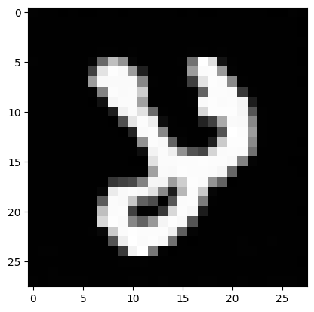
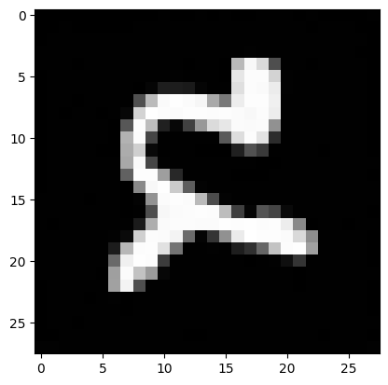
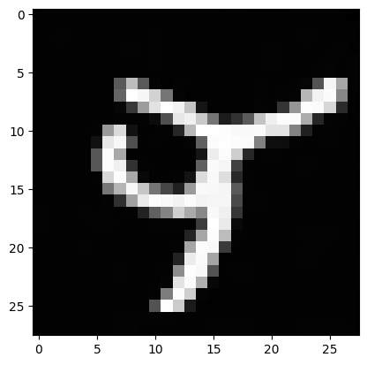
Results from Reverse Process
Using a Linear Schedule on the Variance: 𝝱=[10^-4, 0.02] and T=300
Notes:
Might Remove

Slide 23
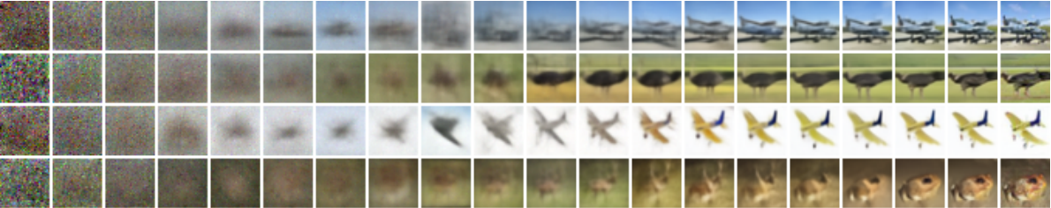
Progressive Generation
Using a Linear Schedule on the Variance: 𝝱=[10^-4, 0.02] and T=1000
CIFAR-10 (Canadian Institute of Advanced Research)

Slide 24
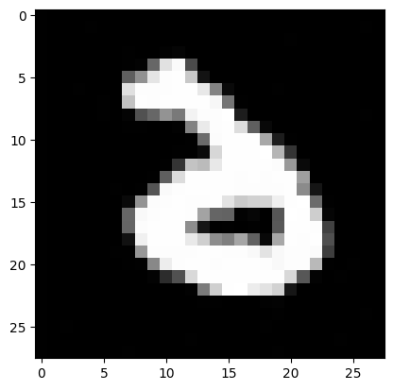
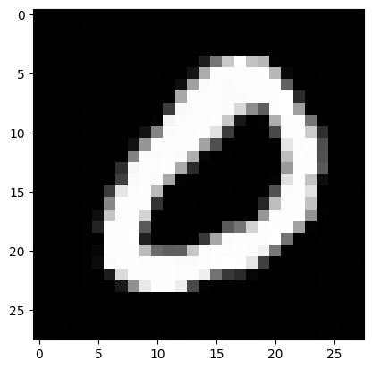
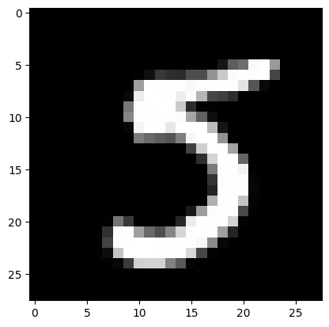
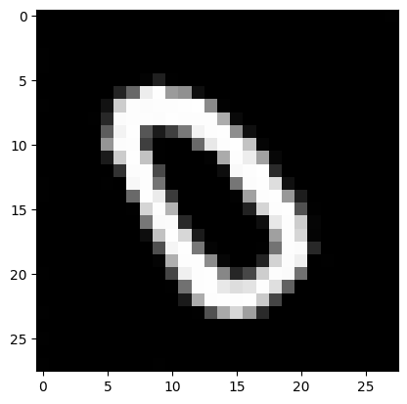
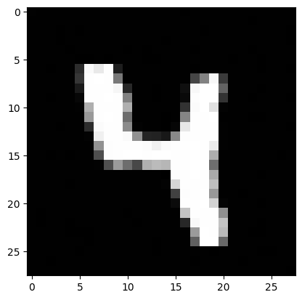
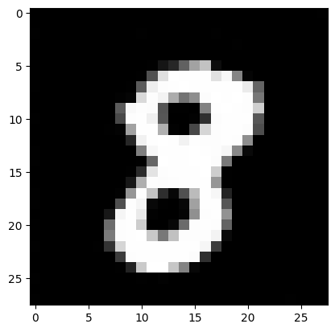
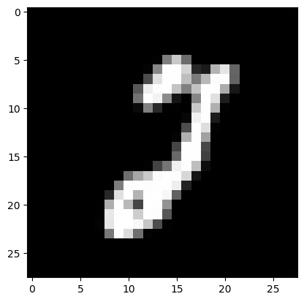
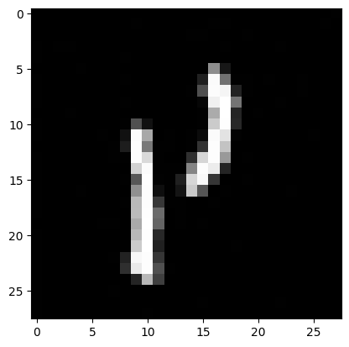
Results from Reverse Process
Using a Cosine Schedule on the Variance: 𝝱=[10^-4, 0.02] and T=300

Slide 25

Animation of Reverse Process
Notes:
Might Remove

Slide 26


